Slide 1
Data Wrangling
Cleaning, Transforming and Organizing Your Data

Slide 2
Topics Covered
Introduction
Data Cleaning
Missing data (Null values)
Outliers
Duplicated
Formatting
Data Transformation:
Structuring: Reshaping Data
Combining: Merging and Joining
Data Organization:
Grouping and Aggregating

Slide 3
Introduction

Slide 4
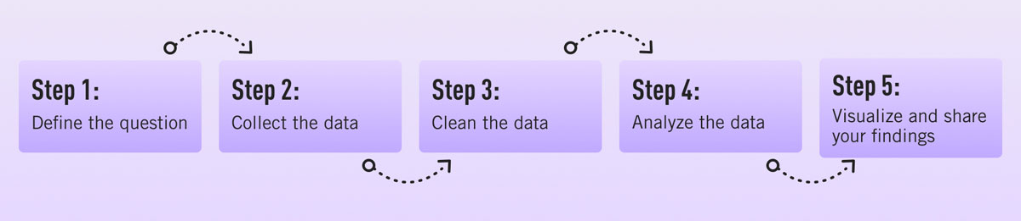
Data Analytics Process
APIs, Web Scraping, Reading databases
Exploratory Data Analysis (EDA) and Descriptive Statistics
Data Wrangling
Tableau, Power BI or other viz tools

Slide 5
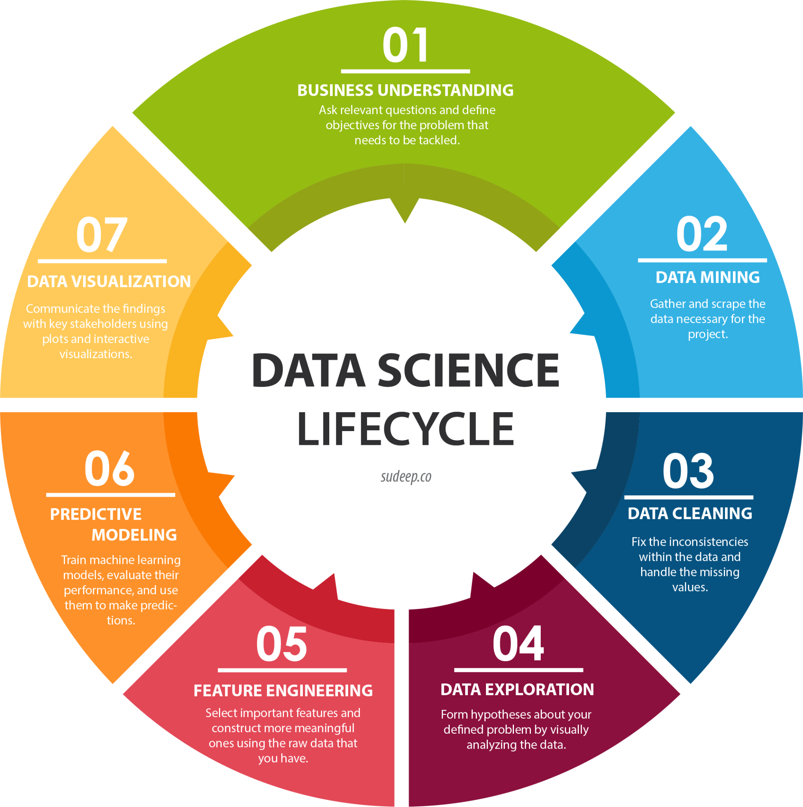
Data Science
Process
Data Science Steps

Slide 6
What is Data Wrangling?
Data wrangling a critical step in the data analytics process. It involves cleaning, transforming, and preparing raw data to make it reliable data suitable for analysis.
60 to 80 percent of the total time is spent on cleaning the data before you can make any meaningful sense of it

Slide 7
Data Wrangling Steps
Data Cleaning
Missing data (Null values)
Outliers
Duplicated
Formatting
Data Transformation
Structuring: Reshaping Data
Combining: Merging and Joining
More: indexes, renaming columns, adding records/columns, editing information etc.
Data Organization
Filtering data
Grouping and Aggregating
Ordering

Slide 8
Data Cleaning: missing values

Slide 9
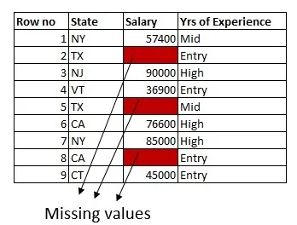
Missing Data (null values)
Missing Values are incomplete or unavailable data in the dataset.
They have different origins:
Data collection errors
Human errors
System failures
Undisclosed data etc.
Impact on Analysis: Biased results, inaccurate insights, incomplete conclusions.
Notes:
Undisclosed data: higher-income earners may not disclose their income

Slide 10
Missing Data (null values)
Handling Approaches:
Replace it with values by making use of information from other columns.
Remove Rows with Missing Values: May lead to data loss and skewed analysis.
Impute with Mean/Median/Interpolation: Fill missing values with a constant, central tendencies or interpolated values.
Machine Learning to predict the value.
Notes:
Undisclosed data: higher-income earners may not disclose their income

Slide 11
Data Cleaning: outliers

Slide 12
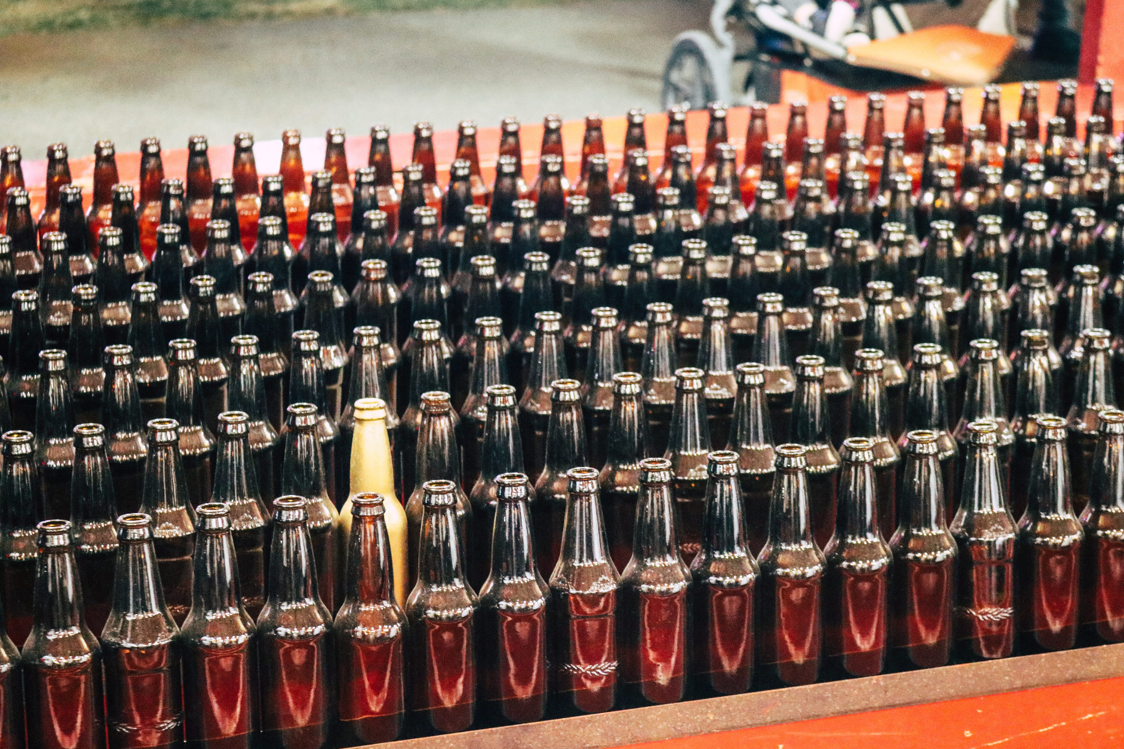
Outliers: Data Anomalies

Slide 13
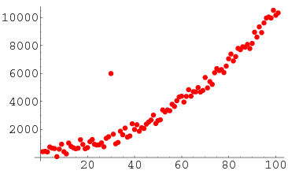
Outliers: Data Anomalies
Unusually extreme or rare data points. It is an abnormal observation that lies far away from other values.
They have different origins:
Data measurement errors, natural variations, or data entry mistakes.
Impact on Analysis
Skewed statistical measures, biased models, inaccurate predictions.
Example: Obvious errors
Values too extreme, so that they are not plausible (1000 years)
Values that do not make sense (-10 years)
Do we discard or include?

Slide 14
Outliers: Data Anomalies
Handling Approaches:
Identify Outliers:
Statistical methods (Z-score, IQR) or visualization (box plots, scatter plots).
Handle Outliers:
Filtering: Removing outliers based on predefined thresholds.
Capping: Capping extreme values to a specified range.
Transformation: Applying mathematical transformations to mitigate impact.
Notes:
We will talk about outliers in EDA

Slide 15
Data Cleaning: duplicates

Slide 16
Duplicated values
Duplicates are records that are “identical” (with minor variations) but that represent the same entity..
Common Occurrence
Data entry errors, system glitches, merging data from different sources.
Impact on Analysis
Inflated statistical results, inaccurate insights, skewed findings.
ID | CITY
1 | New York
2 | New Yorkk

Slide 17
Duplicated values
Duplicates are “identical” records appearing multiple times in the dataset.
Handling Approaches:
Detect Duplicates:
Check for identical rows or key columns.
Fuzzy matching, string similarity algorithms.
Remove Duplicates:
Eliminate duplicate entries to maintain data accuracy.
Group similar records and retain clean, representative data.

Slide 18
Dealing with duplicates: Fuzzy Logic
ID | MODEL
1 | 2021 Ford Focus
2 | 2019 Ford Focus
Percentage of identical fields (> 70%) or n identical values (>10)
A field contains another one
Typing errors: number of different characters (< 3)
ID | NAME
1 | Peppa Pig
2 | Mrs. Peppa Pig
ID | CITY
1 | New York
2 | New Yorkk

Slide 19
Dealing with duplicates
ID | NAME | ADDRESS | CITY | ZIP CODE
1 | Peppa Pig | 145 Brooklyn Ave | NEW YORK | 11213
2 | Mrs. Peppa Pig | Brooklyn Ave | New York | 11213
3 | PEPPA PIG | 145 BROOKLYN AVE | New York | 11213
Consolidate entries into one
ID | NAME | ADDRESS | CITY | ZIP CODE
1 | Peppa Pig | 145 Brooklyn Ave | New York | 11213

Slide 20
Data Cleaning: formatting

Slide 21
string
“101010”
?
string
“101 - 010”
101010
date
10/10/10
time
10:10:10
number
101010

Slide 22
Interpreting the data correctly
A variable can be interpreted in different ways, depending on:
Meaning
Data type
Correctly interpreting the data type is crucial. The format must fit all "known" cases.

Slide 23
Data Transformation: Structuring

Slide 24
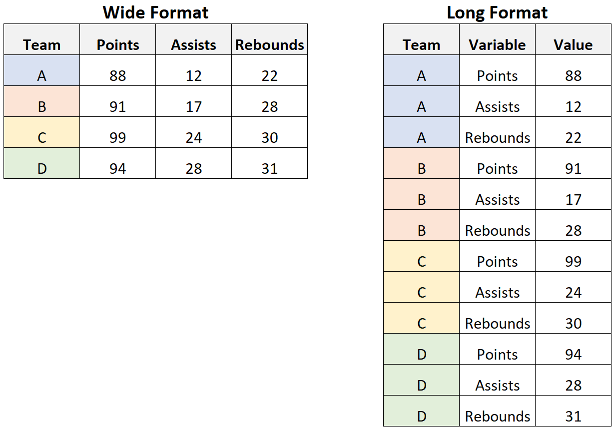
Structuring Data
Reshaping data involves converting data from a wide format to a long format or vice versa.

Slide 25
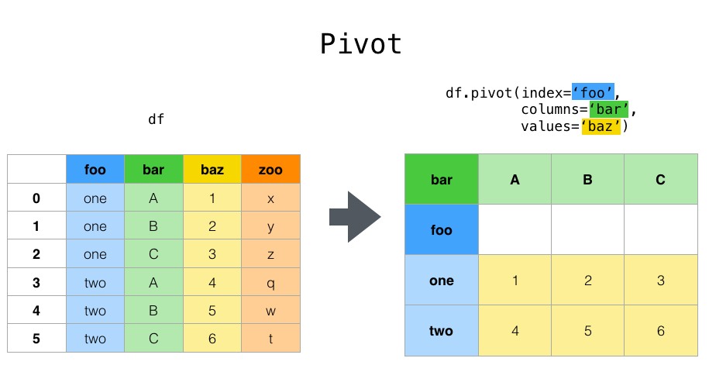
The pivot operation involves reshaping data by converting rows into columns.

Slide 26
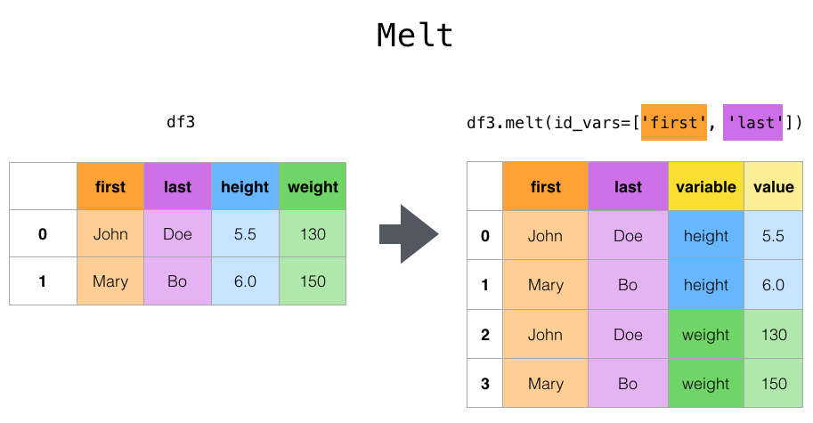
Melt is used to convert data from a wide format to a long format, typically for better analysis and visualization.

Slide 27
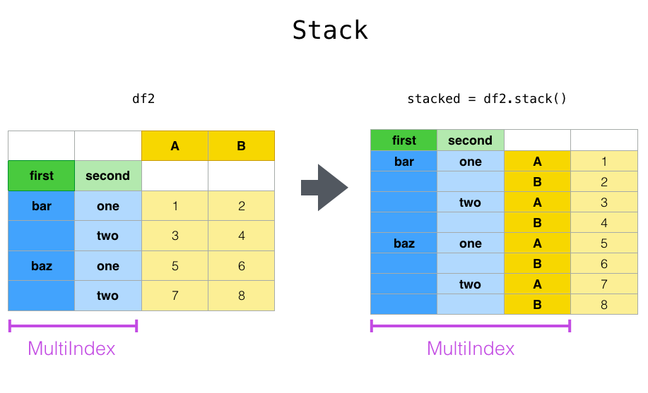
Stack is used to convert data from a wide format to a long format, similar to melt.

Slide 28
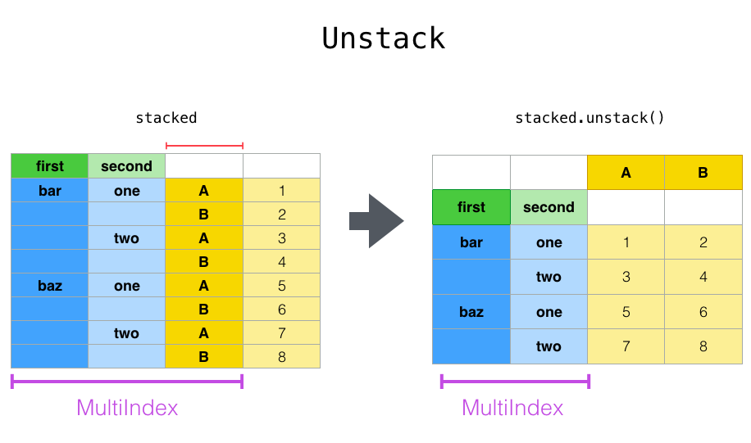
Unstack, on the other hand, performs the reverse operation, converting data from long to wide format.

Slide 29
Data Transformation: Combining

Slide 30
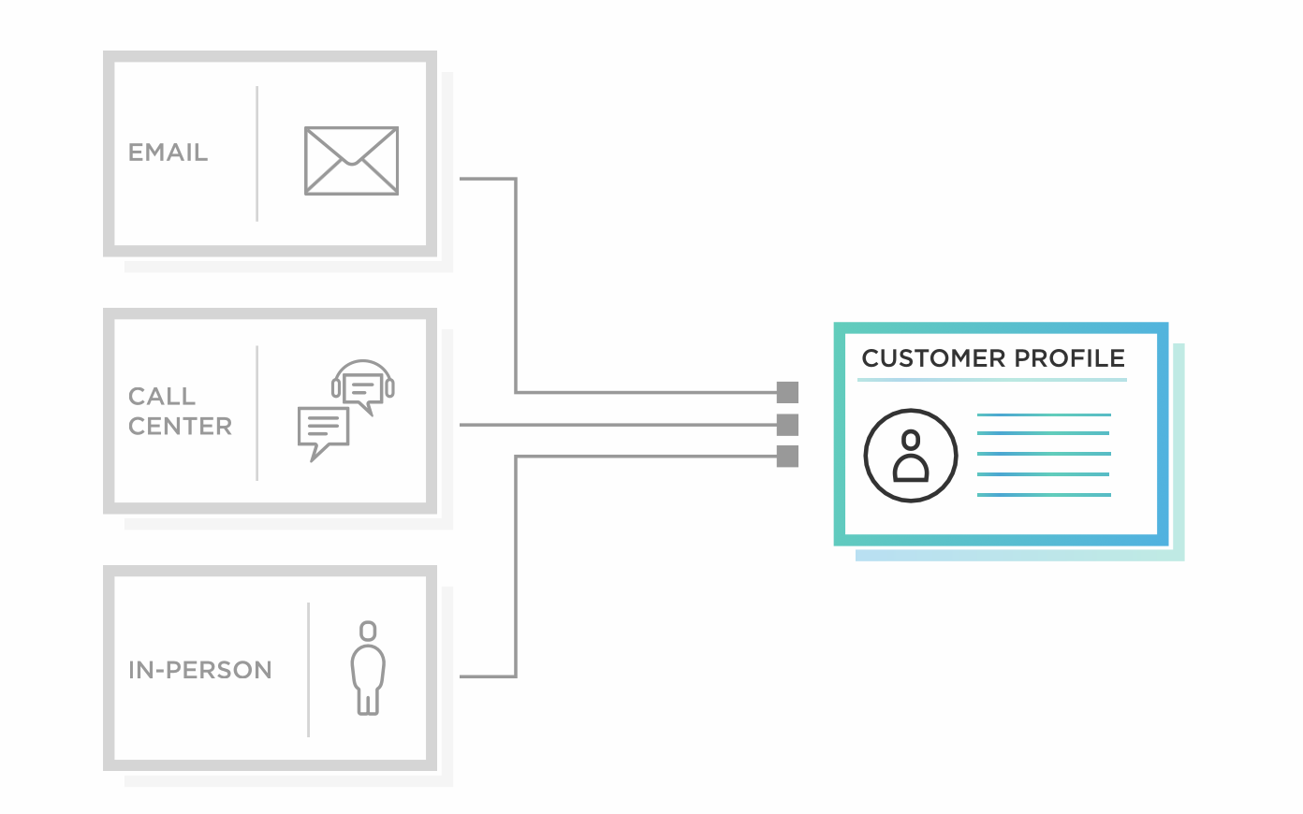
Combining Data
In data analytics, combining data from different sources is a common and essential task.

Slide 31
Vertical Join
Id | Product | Price
1 | Ford Focus | 5000€
2 | Mercedes | 6000€
id | Product | Price | Discount
1 | Ford Focus | 5000€
2 | Mercedes | 6000€
3 | Ford Focus 2 | 7000€ | 500€
4 | BMW | 8000€ | 300€
id | Product | Price | Discount
3 | Ford Focus 2 | 7000€ | 500€
4 | BMW | 8000€ | 300€

Slide 32
Vertical Join
In this type of join, the datasets are stacked vertically to create a larger dataset.
They usually have the same columns (not necessary). If they do, they need to have the same data type.
Concatenation is typically done when datasets represent the same entities or observations over different periods or categories.
In Pandas: “concat”, “append”, ...

Slide 33
Horizontal Join (Merge)
id | Product | Price | Country
1 | Ford Focus | 5000€ | USA
2 | Mercedes Class A | 6000€ | Germany
Id | Product | Price
1 | Ford Focus | 5000€
2 | Mercedes Class A | 6000€
id | Product | Country
1 | Ford Focus | USA
2 | Mercedes Class A | Germany

Slide 34
Horizontal Join (Merge)
Performed when datasets have the same rows but different columns.
Merging or joining is commonly done when datasets contain complementary information about the same entities or observations.

Slide 35
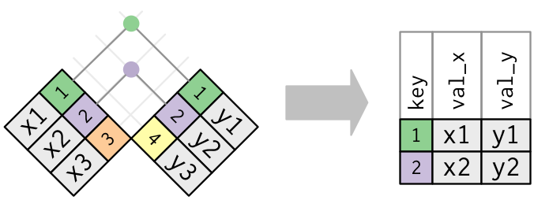
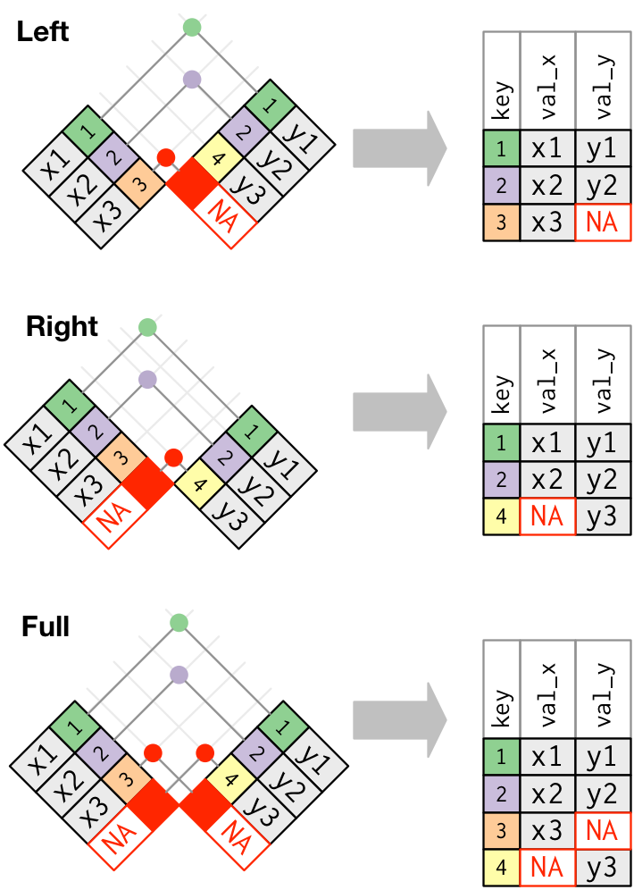
Types of Joins
Inner

Slide 36
Data Organization: Grouping and Aggregating

Slide 37
Grouping and Aggregation
Grouping data is the first step in data aggregation, where we create groups based on specific criteria. For example, we can group data by categories, time periods, or any other relevant attributes.
Once the data is grouped, we can apply aggregation functions to compute summary statistics or perform operations within each group. Common aggregation functions include sum, mean, max, min, count, median, most frequent value etc.

Slide 38
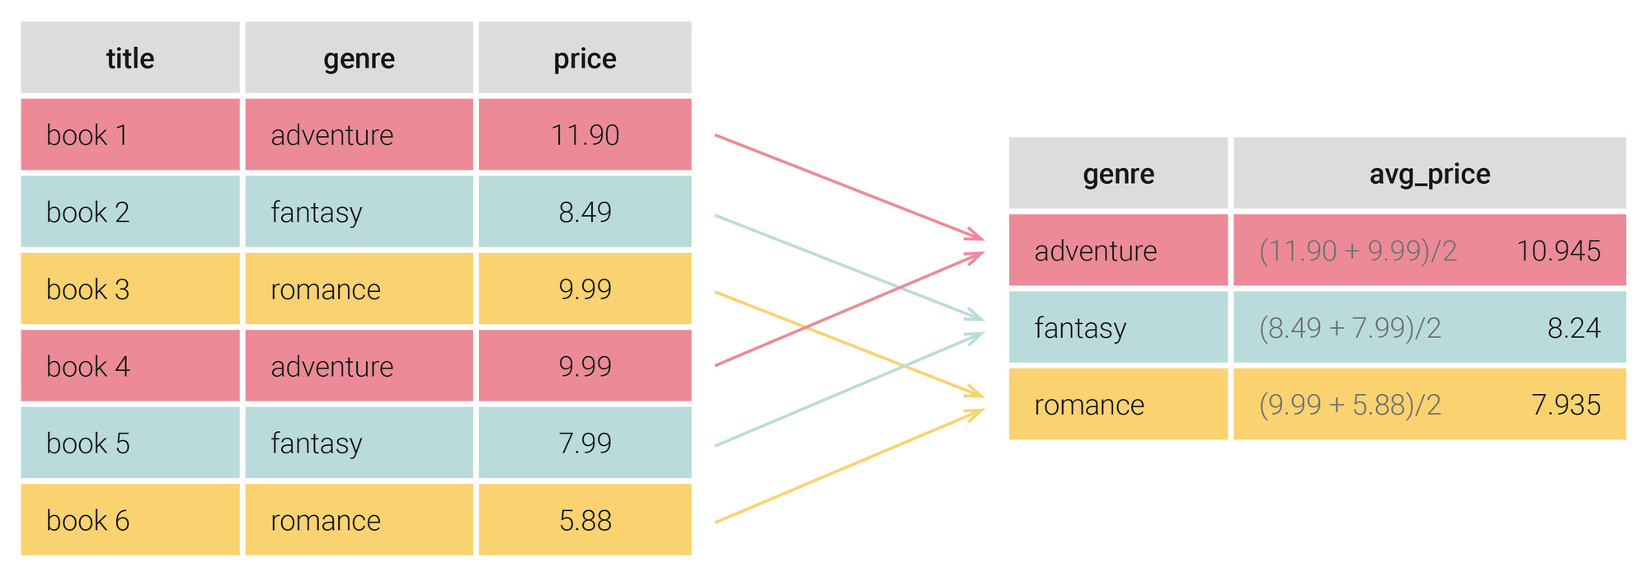
Example
Grouping by genre
Aggregation function: calculating the average

Slide 39
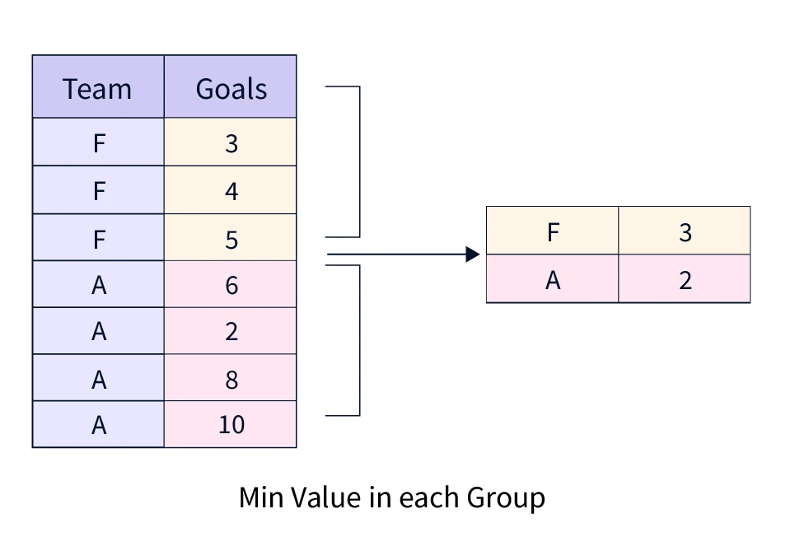
Example
Grouping by Team
Aggregation function: minimum value

Slide 40
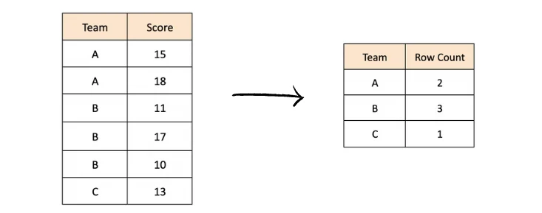
Example
Grouping by Team
Aggregation function: counting cases (rows)

